Slide 1
DNA’s Discovery

Slide 2
You need a piece of notebook paper to take you notes.
Please write down the name of the scientist and what his major contribution was.
The information you need to write will be written in RED.

Slide 3
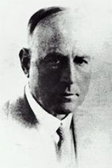
Frederick Griffith 1928
How do bacteria make people sick?
He created an experiment with mice to demonstrate how bacteria can mutate and change.

Slide 4
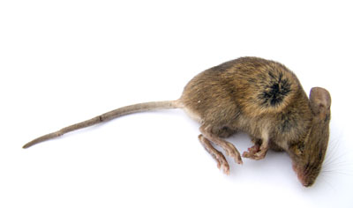
The steps:
Griffith took disease causing bacteria and injected them into mice.
The mice died.

Slide 5
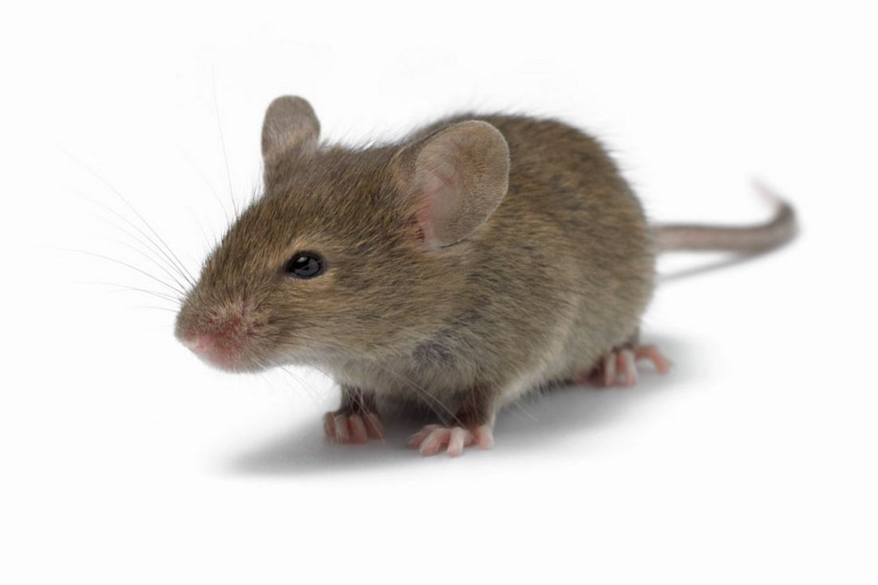
Then….
He took bacteria that did not cause disease and injected it into the mice.
The mice lived! ☺

Slide 6
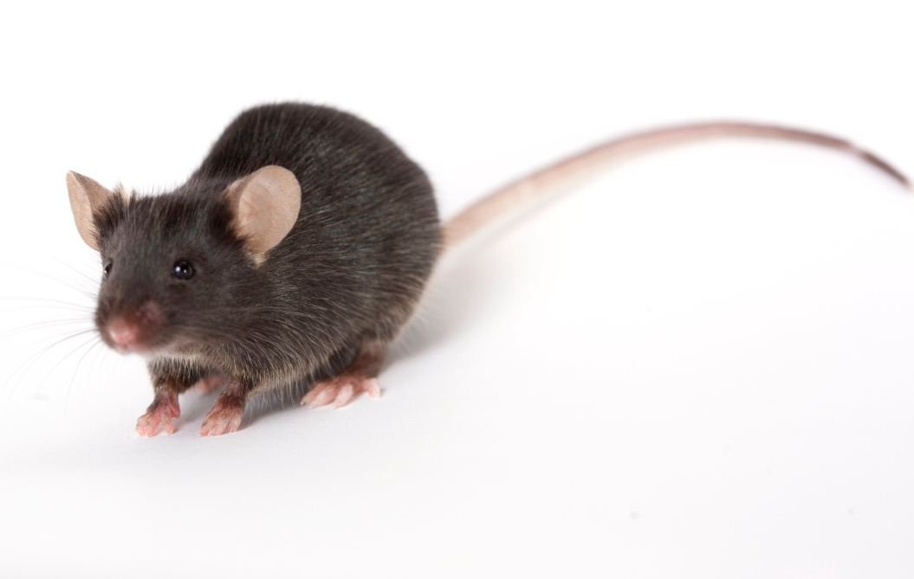
Next…
Griffith then took the disease causing bacteria and heated them.
THEN he injected it into the mice.
THE MICE LIVED!!!

Slide 7
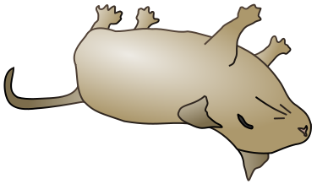
Lastly…
Griffith took the harmless bacteria and the heated bacteria, mixed them together, and injected the mixture into mice.
The mice died!!!

Slide 8
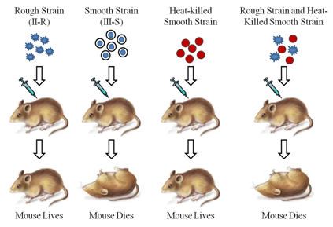
The set up:

Slide 9
The results:
The bacteria had transformed.
Transformation is the process where one strain of bacteria is changed by the genes into another strain.
In transformation, the DNA has permanently changed. ☺

Slide 10
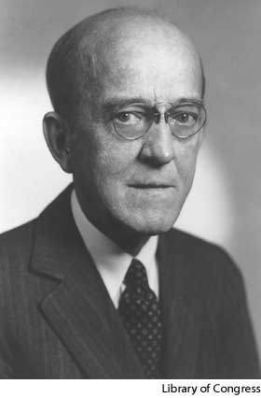
Oswald Avery 1944
Avery wanted to repeat Griffith’s experiment to determine which molecule was important in the transformation of the bacteria.

Slide 11
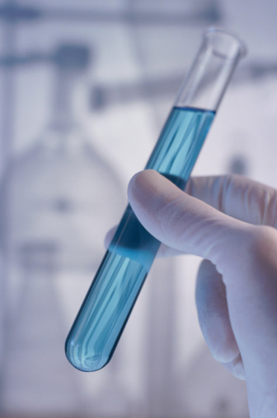
The set up:
Avery made an extract from the heat killed bacteria. He destroyed the proteins, lipids, carbohydrates, and other molecules in the extract.
Transformation still
occurred.

Slide 12
The setup cont.
He then made a second extract, but this time he destroyed the DNA.
Transformation did not occur.

Slide 13
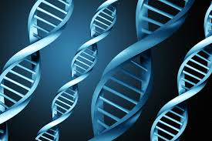
The results:
Avery discovered that DNA stores and transmits the genetic information from one generation to the next.

Slide 14
Alfred Hershey & Martha Chase
1952

Slide 15
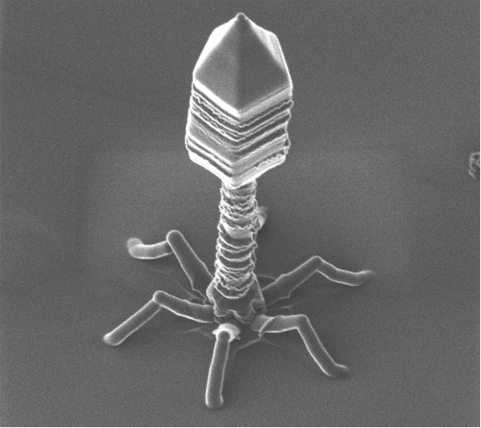
The experiment
These two scientists experimented with bacteriophages.
A bacteriophage is a virus that infects a bacteria.

Slide 16
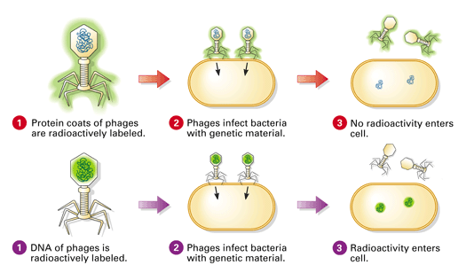

Slide 17
The results:
Hershey and Chase concluded that the genetic material of the bacteriophage was DNA.

Slide 18
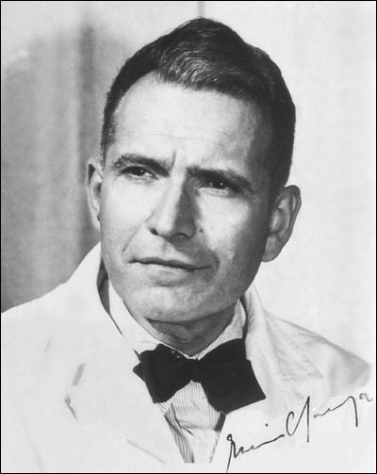
Erwin Chargaff
1950
Chargaff discovered that the percentages of guanine and cytosine are almost identical in each strand of DNA.
He also saw that the percentages of Adenine and Thymine were identical.

Slide 19
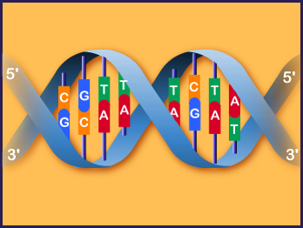
The result:
CHARGAFF’S RULE:
The amount of guanine is equal to the amount of cytosine. ( G = C)
The amount of adenine is equal to the amount of thymine. (A = T)

Slide 20
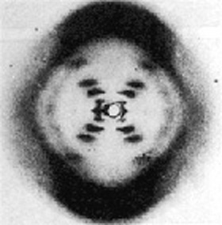
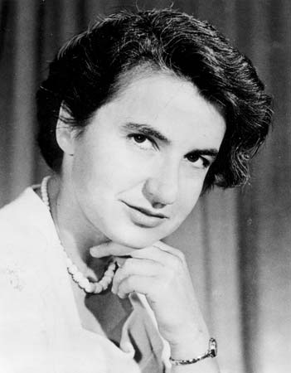
Rosalind Franklin
1952
Franklin used x-rays to get information about DNA. She took a picture that provided clues about the shape of DNA.

Slide 21
Watson and Crick 1953
These two scientists combined all the information that was known about DNA and set out to build a model.
They used paper, wire, glue, and Chargaff’s rules to come up with their idea.
Their model the model that we still use today!

Slide 22
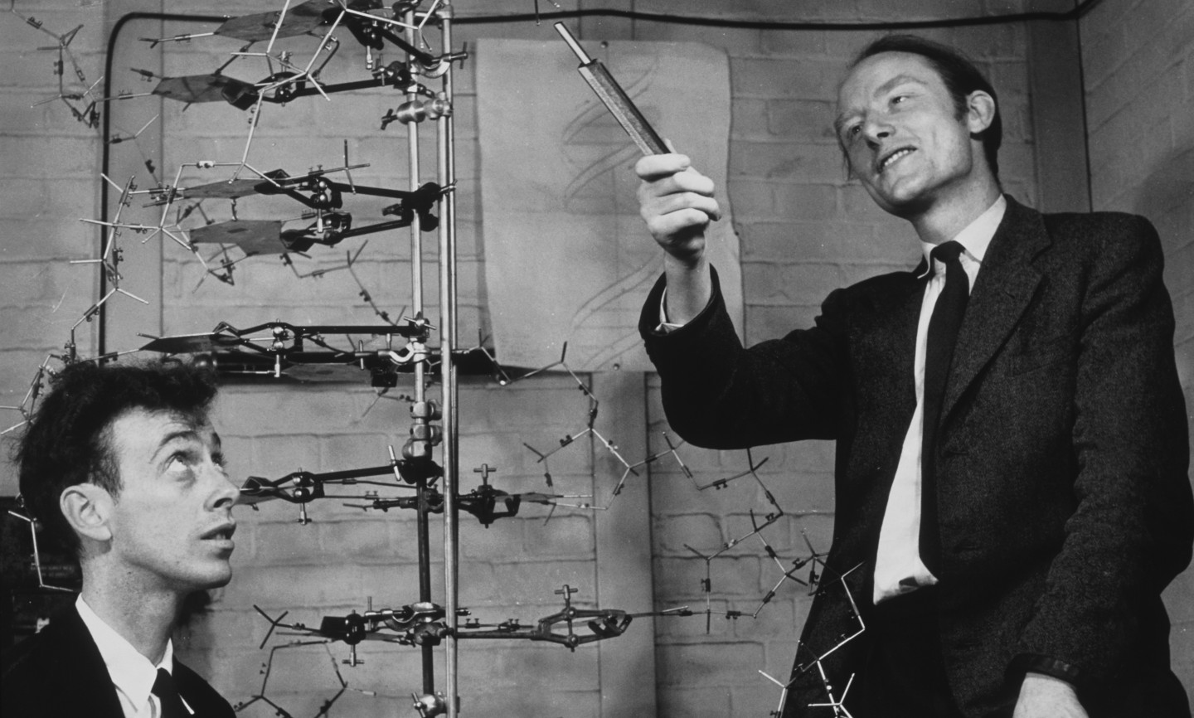

Slide 23
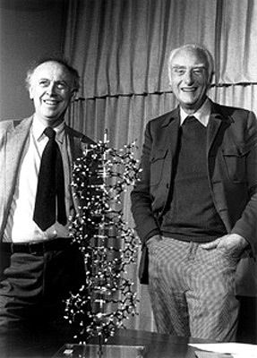
Watson and Crick
The model was a double helix, in which the two strands wound around each other.
The nitrogen bases are paired off.

Slide 24
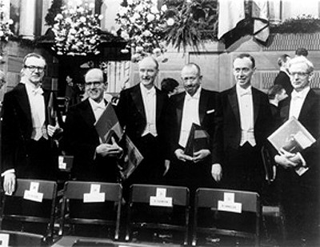
Watson and Crick
In 1962 James Watson (b. 1928), Francis Crick (1916–2004), and Maurice Wilkins (1916–2004) jointly received the Nobel Prize in physiology or medicine.
The Nobel Prize winners for 1962. From left to right: Prof. Maurice Wilkins (for Medicine, along with Watson & Crick), Dr. Max Perutz (UK, for Chemistry), Francis Crick, John Steinbeck (USA, for literature), James Watson, Dr. John Kendrew, (UK, Chemistry).

Slide 25
TED talk with James Watson
https://www.youtube.com/watch?v=2HgL5OFip-0

Slide 26
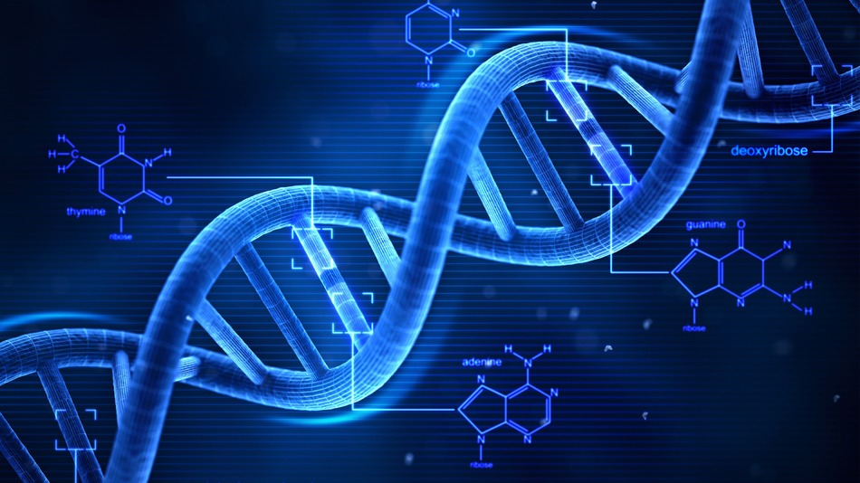
Deoxyribonucleic Acid

